Slide 1
GIT Introduction
Web Programming

Slide 2
Overview
Quick GIT 101
Getting started; we will be revisiting GIT in the Development Environments Course
Scratching the surface, just enough to use it.

Slide 3
History
Originally written by Linus Torvalds
Known for the very popular operating system he humbly named after himself.
He descided to name git after himself aswell.
Silly, incompetent, stupid, annoying, senile, elderly or childish person.
Which Linus is actually also known for being
The idea for git came up, because no other VCS could match the performance needs of the large Linux development

Slide 4
GIT?
Keeps track of ”changes”
Version Control System (VCS)
Many people collaborate on the same projects
History of changes
Developers backtrack all changes(commits)
Has a CLI
GUI’s does exist.
SourceTree
GitHub Desktop
And many many more
Notes:
http://rogerdudler.github.io/git-guide/

Slide 5
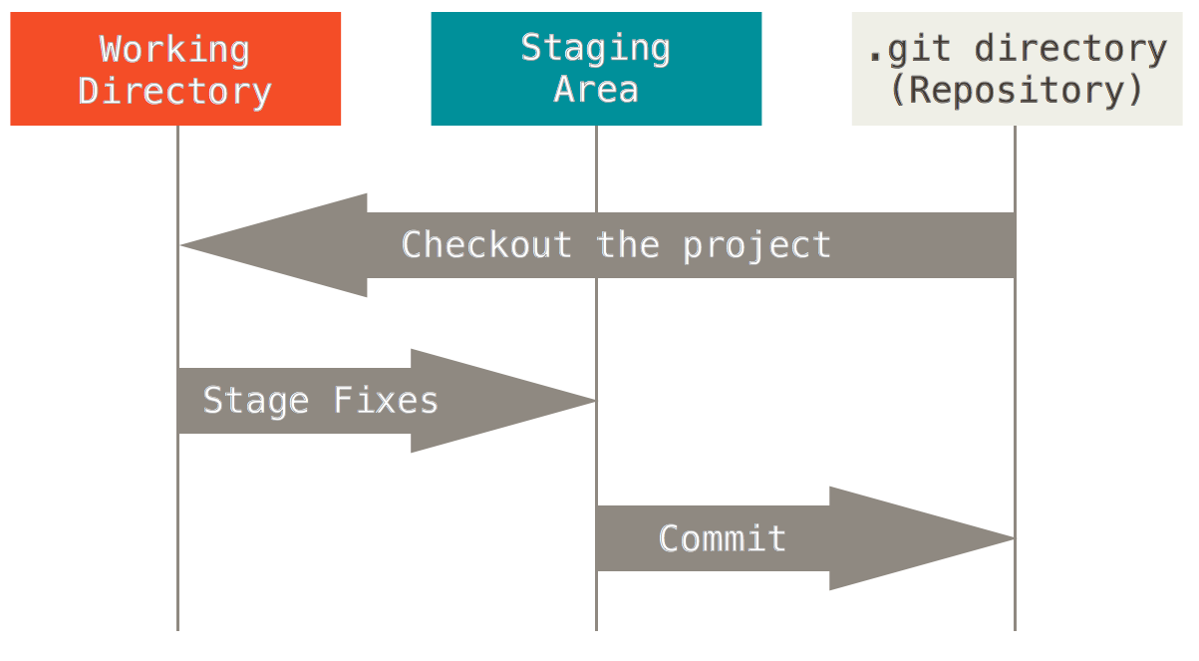
Git basic workflow

Slide 6
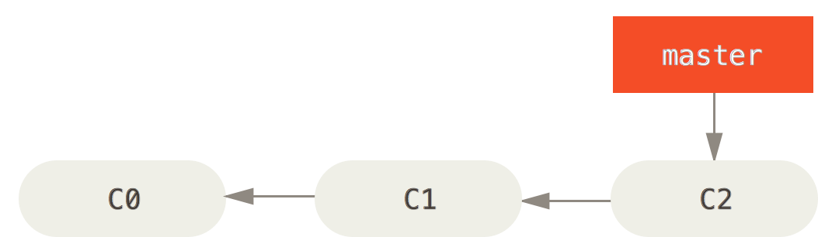
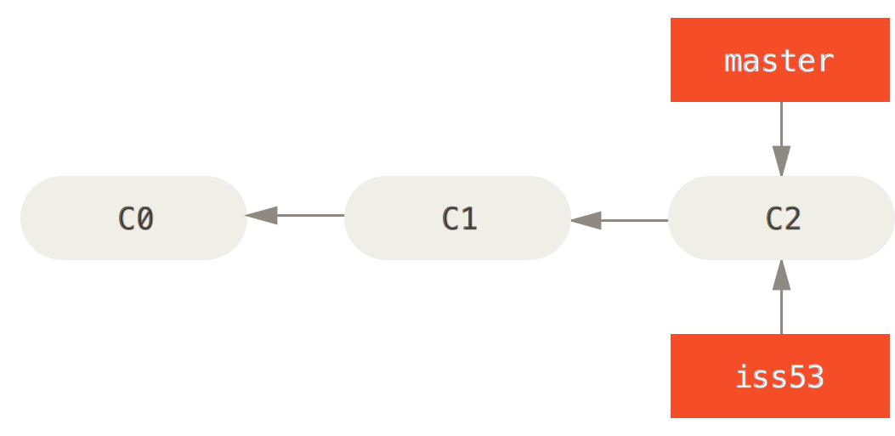
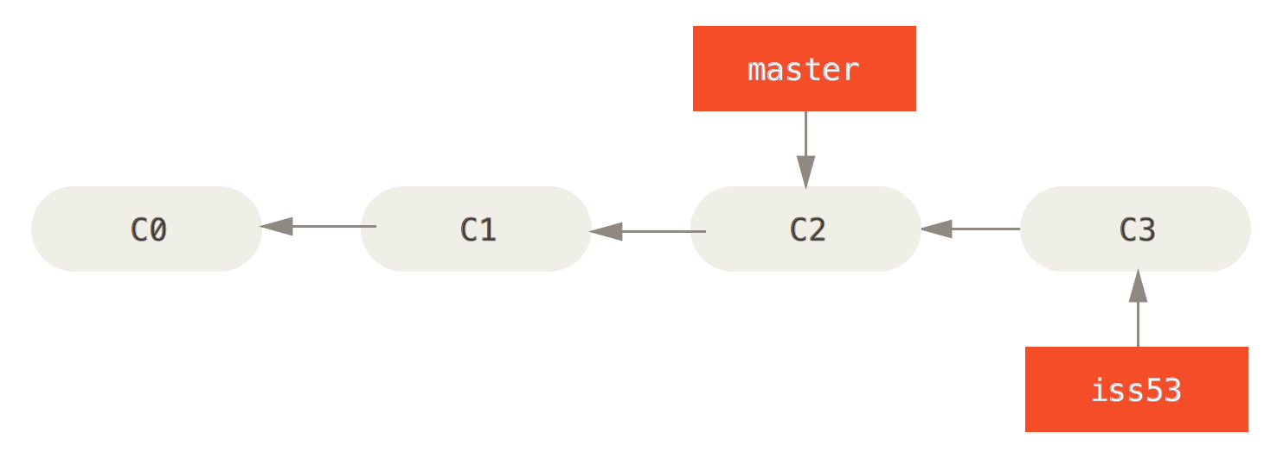

Slide 7
What do we need?
GIT SCM
Thats basically it.
However, a remote repository is nice
BitBucket
GitHub
Unfuddle
Beanstalk
…..

Slide 8
Setup git
$git config –global user.name ”Jens Jensen”
$git config –global user.email ”jens@vcs.dk"
Notes:
https://git-scm.com/book/en/v2/Getting-Started-First-Time-Git-Setup

Slide 9
Adding a folder to version control
Basic Commands
Navigate to Git\bin folder.
sh –login || ”Git bash here.”
$git init – inside a folder, will add version control to this folder.
$git init SOME_NAME, will create a folder, and add version control to it.
$git add –A – add all changes to the version control.
$git add <filename.ext> - add specific change to VC.
$git commit –m ”MESSAGE HERE” commit the change.
$git status – show the status of the current repo
Notes:
Example
Add version control to a folder
Add a file to version control
Git status
Commit the file
Git status
Change the file
Git status
Add the change
Git status
Commit the change

Slide 10
Setting up a remote repository
mkdir /path/to/your/project
cd /path/to/your/project
git init
git remote add origin https://xxxx@bitbucket.org/xxxx/test1.git
git add contributors.txt
git commit -m 'Initial commit with contributors‘
git push -u origin master
Origin master will be saved as default push branch

Slide 11
Setting up a remote repository
The easier way
Create Repo (on BB or GH)
Clone it
Change it
git push origin master

Slide 12
Add existing project to VCS
git remote add origin https://xxxx@bitbucket.org/xxxx/test2.git
git push -u origin --all # pushes up the repo and its refs for the first time
git push -u origin --tags # pushes up any tags

Slide 13
Branching
Branches are typically used for experiments, bugfixes and feature addition.
A branch, is a seperate ”path” to take in the code history, and does not interfere with the master.
To create a branch:
$git branch <name> OR $git checkout –n <name>
Checkout the branch and start working
When you are done, merge the branch into the master; or throw it away.
Allows you to diverge from the master branch, and commit all you want, without changing it.
Notes:
https://git-scm.com/book/en/v2/Git-Branching-Basic-Branching-and-Merging
--no-ff will show the branch in the VCS GUI or BB/GH

Slide 14
Quick lingo recap
Init -> Create a new local repo
Add -> Add change/file to repo
Commit -> Actually decide that the change should be mad
Master -> The main branch
Branch -> Branches can diverge from master
Staging -> Files are added, but not yet committed.
Clone -> Copy an entire repo
Push -> Upload your repo remotely
Pull -> Download changes from the remote repo
Fork(github) -> Clone a repo serverside.
Pull request -> ask someone to take your changes

Slide 15
DEMO
Notes:
CLI:
Add local repo
Add remote
Show GUI

Slide 16
Excercises
Install Git
Git is a version control system that you can use for personal version control or for collaborating with others. I use Git for updating the files for this module in web development. To use Git you first have to install Git on your PC, after doing that you can use Git to download and update all the files.
Install Git from git-scm
Sometimes you have to add Git to the environment variables in Windows - add "C:\Program Files (x86)\Git\cmd" to PATH
Do a clone request $ git clone https://github.com/ucnpbaweb/0914-Web-Programming.git
Each time I add something to the repository browse to the folder and do a pull request
$ git pull
For more help on using Git:
https://www.atlassian.com/git/tutorial/
https://help.github.com/articles/set-up-git

Slide 17
Use Git
The above exercise is just for copying my files to your PC. You can also use Git on your local PC for enabling version control in your own projects. From https://www.atlassian.com/git/tutorial/ (or some other tutorial) try to:
Create a repository
Add files
Commit files
Add a branch
To push your files remotely
Create a remote repo on either BitBucket or GitHub
Configure your local repo with your new remote
Push your repo

